Slide 1
Shield Box Test Setup Communication Subsystem
Ramson Nyamukondiwa
Edgar Mujuni
05/10/2021

Slide 2
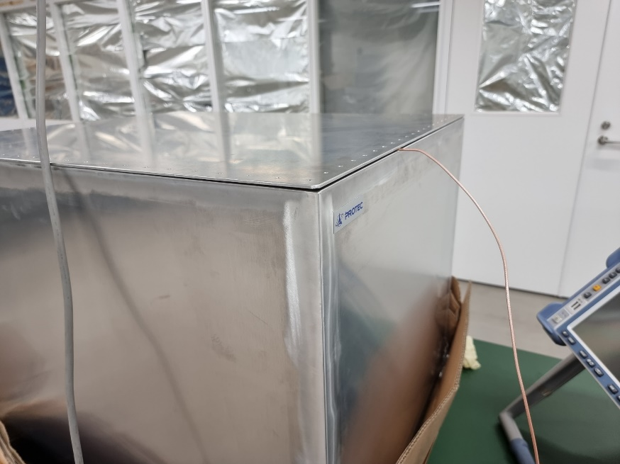
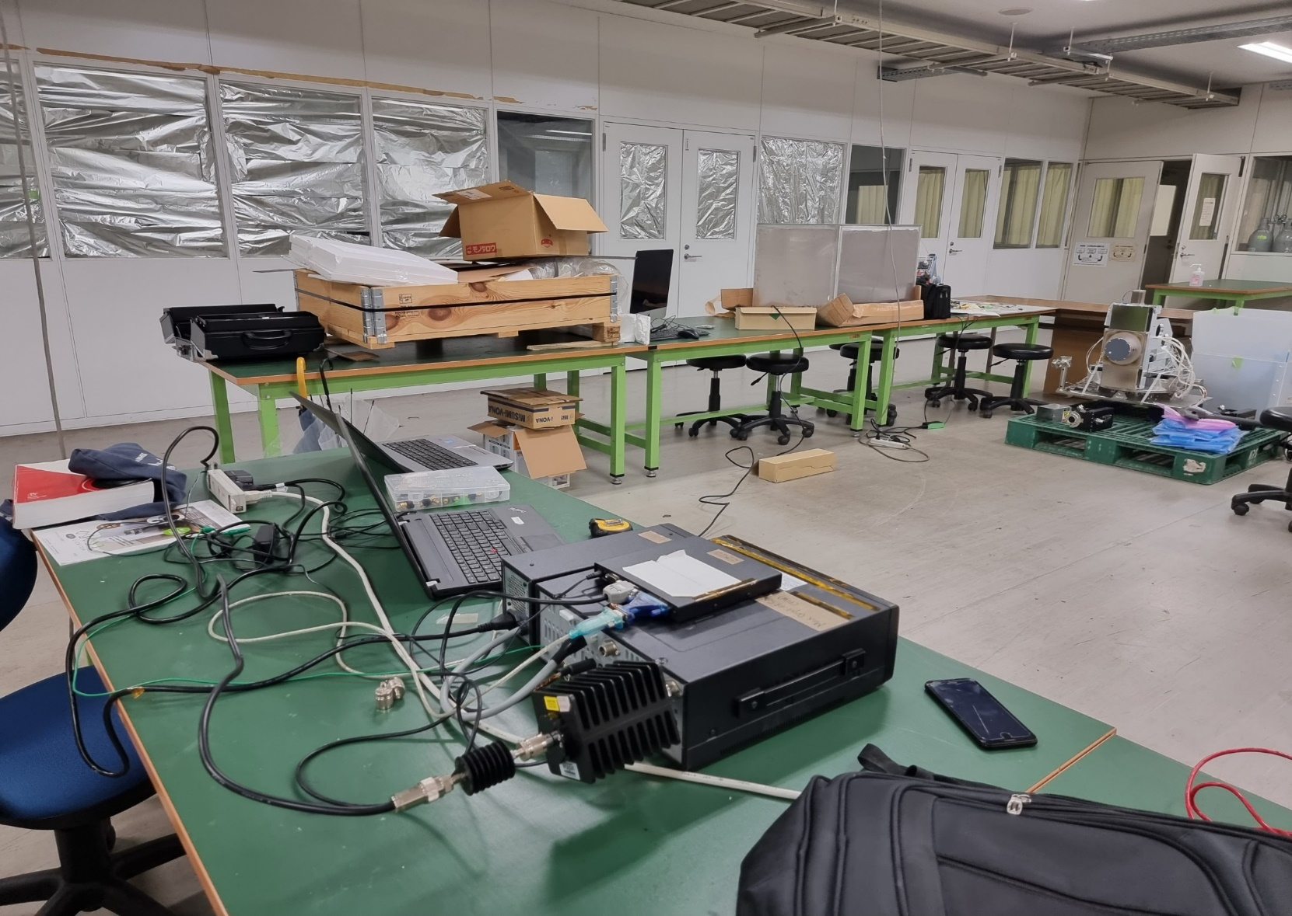
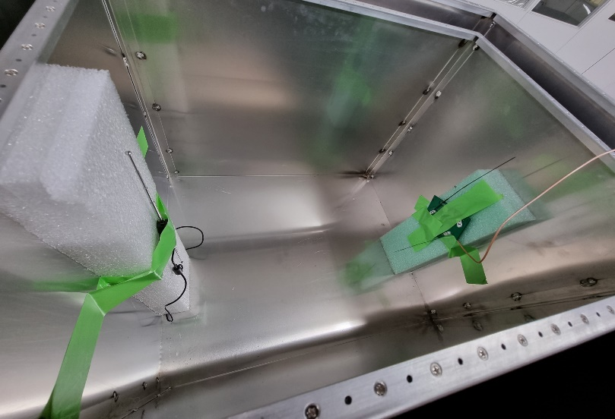
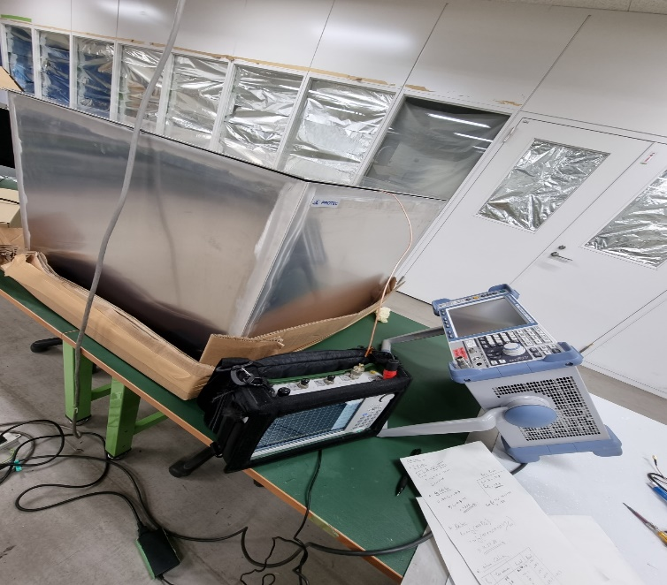
Big Shield Box Test Setup
Closed Box
Overall Setup
Shield Box
Attenuators
SA
Inside the Shield Box
PUPV Sat Ant
RF Cable
GS Setup
Comm Dipole Ant.
D= 0.44 m
Attenuators
Antenna Cal
RF Cable
SA

